Slide 1
An Introduction to Scrum

Slide 2
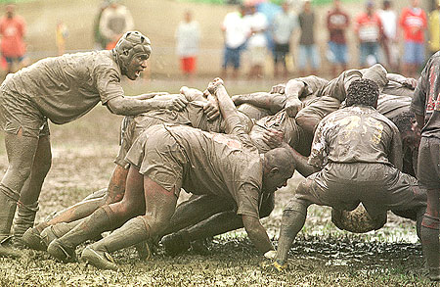
Scrum

Slide 3
Scrum
It is an Agile S/w development method for project management
Characteristics:
Prioritized work is done.
Completion of backlog items
Progress is explained
Agile Software Development

Slide 4

We’re losing the relay race
“The… ‘relay race’ approach to product development…may conflict with the goals of maximum speed and flexibility. Instead a holistic or ‘rugby’ approach—where a team tries to go the distance as a unit, passing the ball back and forth—may better serve today’s competitive requirements.”
Hirotaka Takeuchi and Ikujiro Nonaka, “The New New Product Development Game”, Harvard Business Review, January 1986.
Notes:
would be nice to include a quote from Wicked Problems here

Slide 5
Scrum in 100 words
Scrum is an agile process that allows us to focus on delivering the highest business value in the shortest time.
It allows us to rapidly and repeatedly inspect actual working software (every two weeks to one month).
The business sets the priorities. Teams self-organize to determine the best way to deliver the highest priority features.
Every two weeks to a month anyone can see real working software and decide to release it as is or continue to enhance it for another sprint.

Slide 6
What is Scrum?
Definition from rugby football:
a scrum is a way to restart the game after an interruption, where the forwards of each side come together in a tight formation and struggle to gain possession of the ball when it is tossed in among them

Slide 7
Scrum - an agile process
SCRUM is an agile, lightweight process for managing and controlling software and product development in rapidly changing environments.
Iterative, incremental process
Team-based approach
developing systems/ products with rapidly changing requirements
Controls the chaos of conflicting interest and needs
Improve communication and maximize cooperation
Protecting the team form disruptions and impediments
A way to maximize productivity

Slide 8
Scrum has been used by:
Microsoft
Yahoo
Google
Electronic Arts
High Moon Studios
Lockheed Martin
Philips
Siemens
Nokia
Capital One
BBC
Intuit
Intuit
Nielsen Media
First American Real Estate
BMC Software
Ipswitch
John Deere
Lexis Nexis
Sabre
Salesforce.com
Time Warner
Turner Broadcasting
Oce

Slide 9
Scrum has been used for:
Commercial software
In-house development
Contract development
Fixed-price projects
Financial applications
ISO 9001-certified applications
Embedded systems
24x7 systems with 99.999% uptime requirements
the Joint Strike Fighter
Video game development
FDA-approved, life-critical systems
Satellite-control software
Websites
Handheld software
Mobile phones
Network switching applications
ISV applications
Some of the largest applications in use

Slide 10
Characteristics
Self-organizing teams
Product progresses in a series of month-long “sprints”
Requirements are captured as items in a list of “product backlog”
No specific engineering practices prescribed
Uses generative rules to create an agile environment for delivering projects
One of the “agile processes”

Slide 11

The Agile Manifesto–a statement of values
Individuals and interactions
Process and tools
over
Working software
Comprehensive documentation
over
Customer collaboration
Contract negotiation
over
Responding to change
Following a plan
over
Source: www.agilemanifesto.org

Slide 12
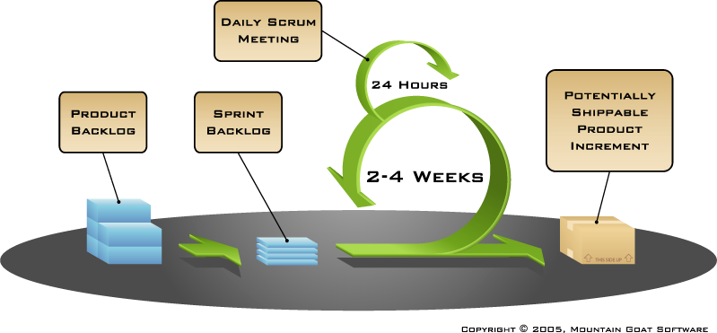
Functionality of Scrum

Slide 13
Putting it all together

Slide 14
Sprints
Scrum projects make progress in a series of “sprints”
Analogous to Extreme Programming iterations
Typical duration is 2–4 weeks or a calendar month at most
A constant duration leads to a better rhythm
Product is designed, coded, and tested during the sprint

Slide 15
Sequential vs. overlapping development
Requirements
Design
Code
Test
Rather than doing all of one thing at a time...
...Scrum teams do a little of everything all the time
Source: “The New New Product Development Game” by Takeuchi and Nonaka. Harvard Business Review, January 1986.

Slide 16


No changes during a sprint
Change
Plan sprint durations around how long you can commit to keeping change out of the sprint

Slide 17
Scrum framework
Roles
Product owner
ScrumMaster
Team
Ceremonies
Sprint planning
Sprint review
Sprint retrospective
Daily scrum meeting
Artifacts
Product backlog
Sprint backlog
Burndown charts

Slide 18
Scrum framework
Roles
Product owner
ScrumMaster
Team
Ceremonies
Sprint planning
Sprint review
Sprint retrospective
Daily scrum meeting
Artifacts
Product backlog
Sprint backlog
Burndown charts

Slide 19

Product owner
Define the features of the product
Decide on release date and content
Be responsible for the profitability of the product (ROI)
Prioritize features according to market value
Adjust features and priority every iteration, as needed
Accept or reject work results
Acts like one voice (in any case)
Knows what needs to be build and in what sequence this should be done
Typically a product manager

Slide 20

The ScrumMaster
Represents management to the project
Responsible for enacting Scrum values and practices
Removes impediments
Ensure that the team is fully functional and productive
Enable close cooperation across all roles and functions
Shield the team from external interferences
Typically filled by a Project Manager or Team Leader

Slide 21





The scrum team
Typically 5-9 people
Cross-functional:
Programmers, testers, user experience designers, etc.
Members should be full-time
May be exceptions (e.g., database administrator)
Team is self-organizing
Membership can change only between sprints

Slide 22
The team
Teams are self-organizing
Ideally, no titles but rarely a possibility
Membership should change only between sprints

Slide 23
Scrum framework
Roles
Product owner
ScrumMaster
Team
Ceremonies
Sprint planning
Sprint review
Sprint retrospective
Daily scrum meeting
Artifacts
Product backlog
Sprint backlog
Burndown charts

Slide 24
Sprint Planning Meeting
A collaborative meeting in the beginning of each Sprint between the Product Owner, the Scrum Master and the Team
Takes 8 hours and consists of 2 parts (“before lunch and after lunch”)

Slide 25
Parts of Sprint Planning Meeting
1st Part:
Creating Product Backlog
Determining the Sprint Goal.
Participants: Product Owner, Scrum Master, Scrum Team
2nd Part:
Participants: Scrum Master, Scrum Team
Creating Sprint Backlog

Slide 26


Team capacity
Sprint planning meeting
Sprint prioritization
Product backlog
Sprint
goal
Analyze and evaluate product backlog
Select sprint goal
Business conditions
Sprint planning
Decide how to achieve sprint goal (design)
Create sprint backlog (tasks) from product backlog items (user stories / features)
Estimate sprint backlog in hours
Current product
Sprint
backlog
Technology

Slide 27

Sprint planning
Team selects items from the product backlog they can commit to completing
Sprint backlog is created
Tasks are identified and each is estimated (1-16 hours)
Collaboratively, not done alone by the ScrumMaster
High-level design is considered
As a vacation planner, I want to see photos of the hotels.
Code the middle tier (8 hours)
Code the user interface (4)
Write test fixtures (4)
Code the foo class (6)
Update performance tests (4)

Slide 28
Pre-Project/Kickoff Meeting
A special form of Sprint Planning Meeting
Meeting before the begin of the Project

Slide 29
Sprint
A month-long iteration, during which is incremented a product functionality
NO outside influence can interference with the Scrum team during the Sprint
Each Sprint begins with the Daily Scrum Meeting

Slide 30
Daily Scrum
Is a short (15 minutes long) meeting, which is held every day before the Team starts working
Participants: Scrum Master (which is the chairman), Scrum Team
Every Team member should answer on 3 questions

Slide 31

Everyone answers 3 questions
1
What did you do yesterday?
2
What will you do today?
3
Is anything in your way?
These are not status for the ScrumMaster
They are commitments in front of peers

Slide 32
Daily Scrum
Is NOT a problem solving session
Is NOT a way to collect information about WHO is behind the schedule
Is a meeting in which team members make commitments to each other and to the Scrum Master
Is a good way for a Scrum Master to track the progress of the Team

Slide 33
The daily scrum
Parameters
Daily
15-minutes
Stand-up
Not for problem solving
Whole world is invited
Only team members, ScrumMaster, product owner, can talk
Helps avoid other unnecessary meetings

Slide 34
The sprint review
Team presents what it accomplished during the sprint
Typically takes the form of a demo of new features or underlying architecture
Informal
2-hour prep time rule
No slides
Whole team participates
Invite the world

Slide 35
Sprint Review Meeting
Is held at the end of each Sprint
Business functionality which was created during the Sprint is demonstrated to the Product Owner
Informal, should not distract Team members of doing their work

Slide 36
Sprint retrospective
Periodically take a look at what is and is not working
Typically 15–30 minutes
Done after every sprint
Whole team participates
ScrumMaster
Product owner
Team
Possibly customers and others

Slide 37

Start / Stop / Continue
Whole team gathers and discusses what they’d like to:
Start doing
Stop doing
This is just one of many ways to do a sprint retrospective.
Continue doing

Slide 38
Scrum framework
Roles
Product owner
ScrumMaster
Team
Ceremonies
Sprint planning
Sprint review
Sprint retrospective
Daily scrum meeting
Artifacts
Product backlog
Sprint backlog
Burndown charts

Slide 39

Product backlog
The requirements
A list of all desired work on the project
Ideally expressed such that each item has value to the users or customers of the product
Prioritized by the product owner
Reprioritized at the start of each sprint
This is the product backlog

Slide 40
A sample product backlog
Backlog item | Estimate
Allow a guest to make a reservation | 3
As a guest, I want to cancel a reservation. | 5
As a guest, I want to change the dates of a reservation. | 3
As a hotel employee, I can run RevPAR reports (revenue-per-available-room) | 8
Improve exception handling | 8
... | 30
... | 50

Slide 41
Estimation of Product Backlog Items
Establishes team’s velocity (how much Effort a Team can handle in one Sprint)
Determining units of complexity.
Size-category (“T-Shirt size”)
Story points
Work days/work hours
Methods of estimation:
Expert Review
Creating a Work Breakdown Structure (WBS)

Slide 42
Product Backlog
Is only a FORECAST!-> is not exact

Slide 43
Sprint Backlog
A subset of Product Backlog Items, which define the work for a Sprint
Is created ONLY by Team members
Each Item has it’s own status
Should be updated every day

Slide 44
The sprint goal
A short statement of what the work will be focused on during the sprint
Life Sciences
Support features necessary for population genetics studies.
Database Application
Make the application run on SQL Server in addition to Oracle.
Financial services
Support more technical indicators than company ABC with real-time, streaming data.

Slide 45
Managing the sprint backlog
Individuals sign up for work of their own choosing
Work is never assigned
Estimated work remaining is updated daily

Slide 46
Managing the sprint backlog
Any team member can add, delete or change the sprint backlog
Work for the sprint emerges
If work is unclear, define a sprint backlog item with a larger amount of time and break it down later
Update work remaining as more becomes known

Slide 47
A sprint backlog
Tasks
Mon
Tues
Wed
Thur
Fri
Code the user interface
8
4
8
Code the middle tier
16
12
10
4
Test the middle tier
8
16
16
11
8
Write online help
12
Write the foo class
8
8
8
8
8
Add error logging
8
4

Slide 48
Sprint Backlog
A subset of Product Backlog Items, which define the work for a Sprint
Is created ONLY by Team members
Each Item has it’s own status
Should be updated every day

Slide 49
Sprint Backlog
No more then 300 tasks in the list
If a task requires more than 16 hours, it should be broken down
Team can add or subtract items from the list. Product Owner is not allowed to do it

Slide 50
Sprint Backlog
Is a FORECAST!
Is a good warning monitor

Slide 51
Burn down Charts
Are used to represent “work done”.
Are wonderful Information Radiators
3 Types:
Sprint Burn down Chart (progress of the Sprint)
Release Burn down Chart (progress of release)
Product Burn down chart (progress of the Product)

Slide 52
Information Radiator
"Two characteristics are key to a good information radiator. The first is that the information changes over time. This makes it worth a person's while to look at the display... The other characteristic is that it takes very little energy to view the display."

Slide 53
Burn down Charts
X-Axis: time (usually in days)
Y-Axis: remaining effort

Slide 54
Sprint Burn down Chart
Depicts the total Sprint Backlog hours remaining per day
Shows the estimated amount of time to release
Ideally should burn down to zero to the end of the Sprint
Actually is not a straight line
Can bump UP

Slide 55
Release Burn down Chart
Will the release be done on right time?
X-axis: sprints
Y-axis: amount of hours remaining
The estimated work remaining can also burn up

Slide 56
Alternative Release Burn down Chart
Consists of bars (one for each sprint)
Values on the Y-axis: positive AND negative
Is more informative then a simple chart

Slide 57
Product Burn down Chart
Is a “big picture” view of project’s progress (all the releases)

Slide 58

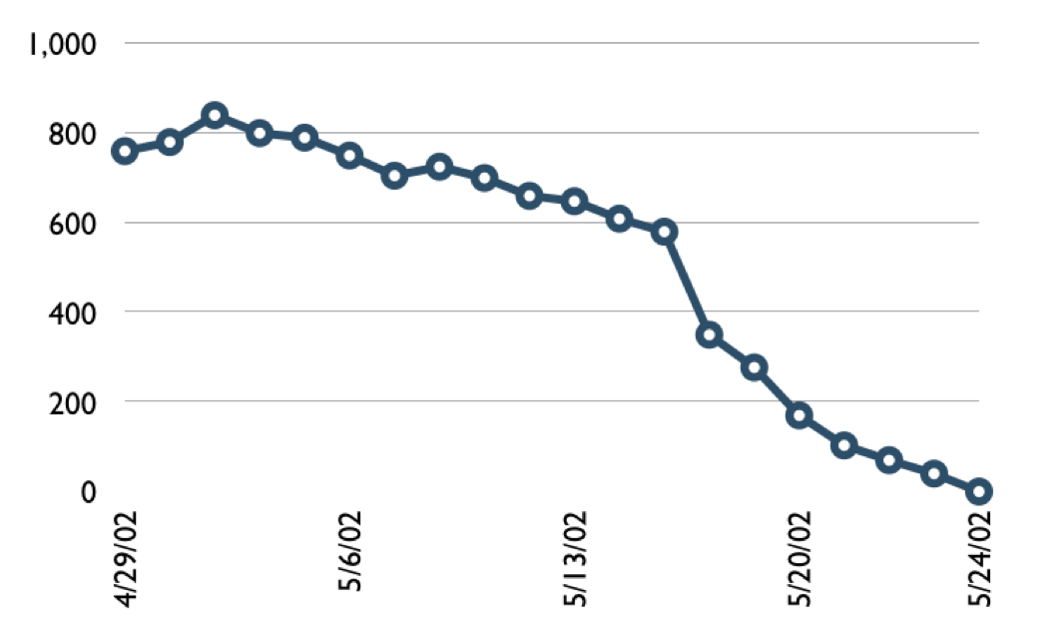
A sprint burndown chart
Hours

Slide 59
Tasks
Mon
Tues
Wed
Thur
Fri
Code the user interface
8
4
8
Code the middle tier
16
12
10
7
Test the middle tier
8
16
16
11
8
Write online help
12
50
40
30
Hours
20
10
0
Mon
Tue
Wed
Thu
Fri

Slide 60
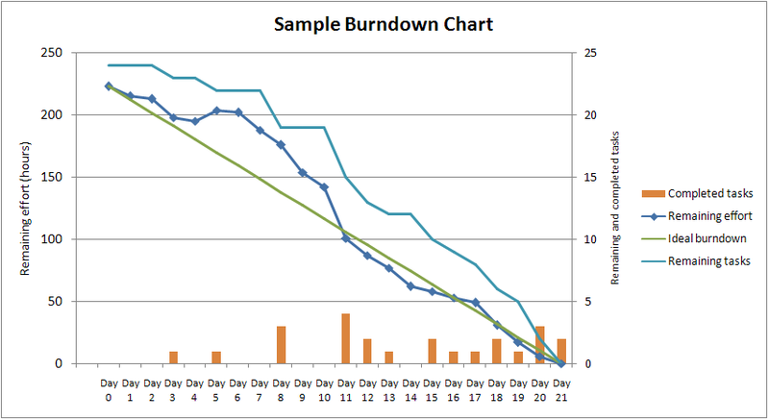
Example of Sprint Burndown Chart

Slide 61
Scalability
Typical individual team is 7 ± 2 people
Scalability comes from teams of teams
Factors in scaling
Type of application
Team size
Team dispersion
Project duration
Scrum has been used on multiple 500+ person projects

Slide 62






Scaling through the Scrum of scrums

Slide 63
Scaling Scrum
A typical Scrum team is 6-10 people
Jeff Sutherland - up to over 800 people
"Scrum of Scrums" or what called "Meta-Scrum“
Frequency of meetings is based on the degree of coupling between packets

Slide 64
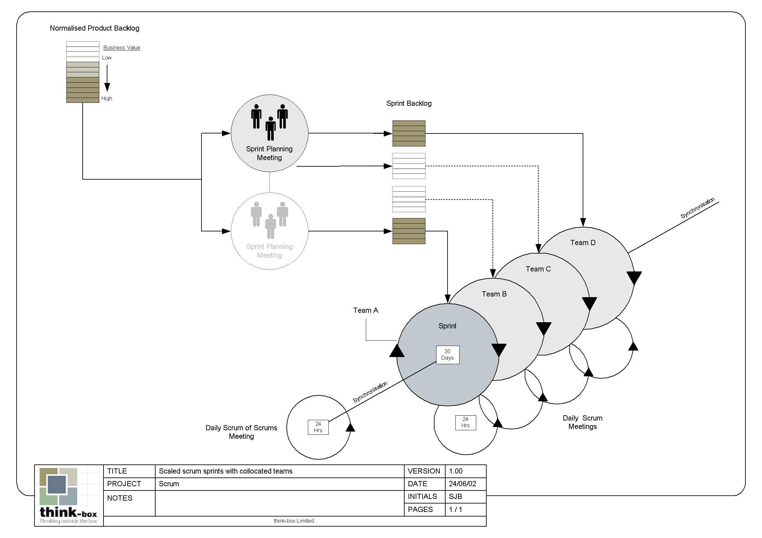
Scaling Scrum

Slide 65
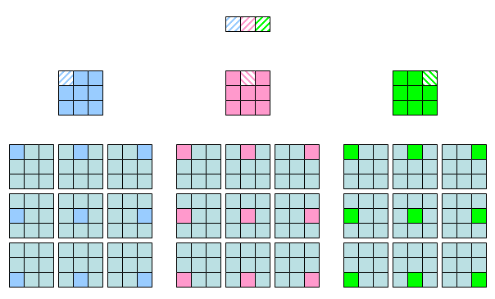
Scaling Scrum

Slide 66
Scrum of scrums of scrums

Slide 67
Pro/Con
Advantages
Completely developed and tested features in short iterations
Simplicity of the process
Clearly defined rules
Increasing productivity
Self-organizing
each team member carries a lot of responsibility
Improved communication
Combination with Extreme Programming
Drawbacks
“Undisciplined hacking” (no written documentation)
Violation of responsibility
Current mainly carried by the inventors

Slide 68
www.mountaingoatsoftware.com

